Slide 1
Praying For Souls
Praying for the Harvest

Slide 2
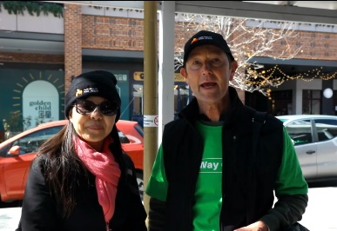
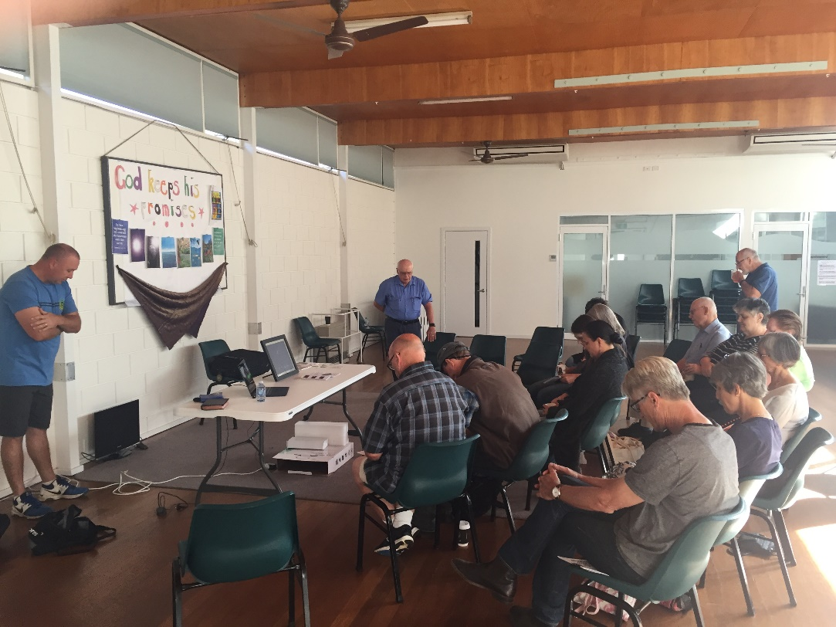
The Way of Life Campaign Initiative
https://www.australiaforjesus.org.au/wayoflife/
GOULBURN, NSW

Slide 3
Out There With The Lost
ADELAIDE, CBD

Slide 4
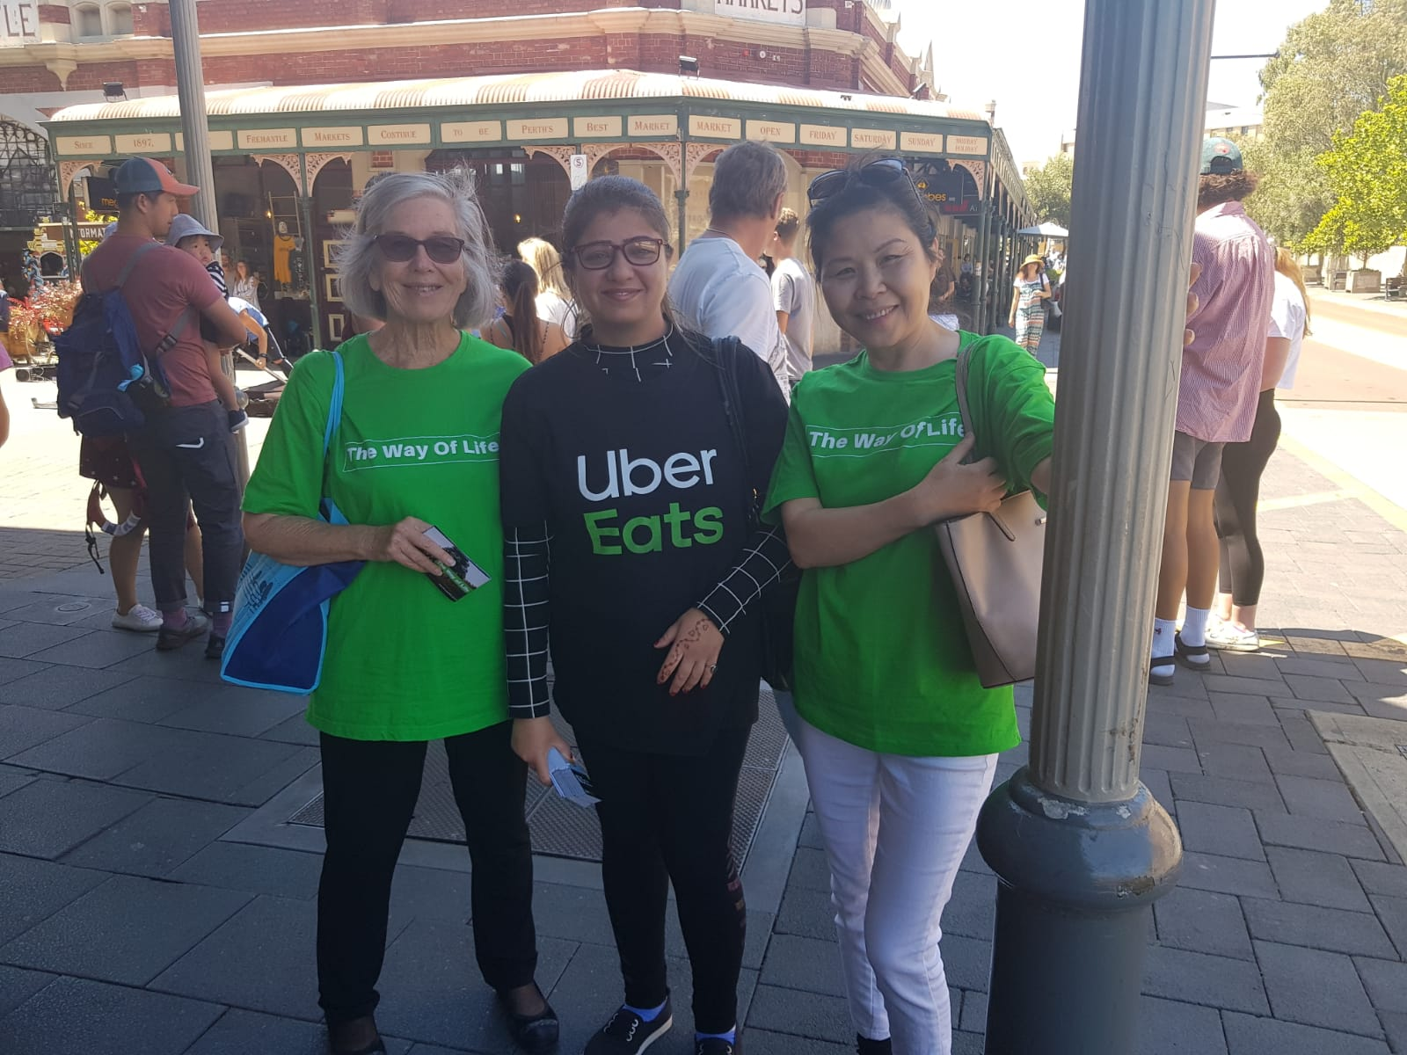
Praying For Souls
FREMANTLE, WA

Slide 5
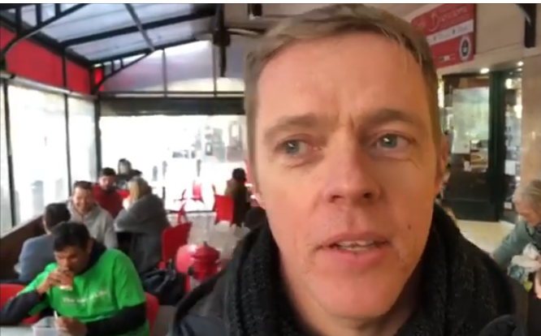
Praying For Souls
NORWOOD,
ADELAIDE

Slide 6
Praying For Souls

Slide 7
Praying For Souls

Slide 8
Praying For Souls Results to 19 October 19
359 Way of Life Campaigns
1536 Partial Presentations
2032 Full Presentations
933 Response Prayers
619 Info Requests

Slide 9
933 Response Prayers Recorded

Slide 10
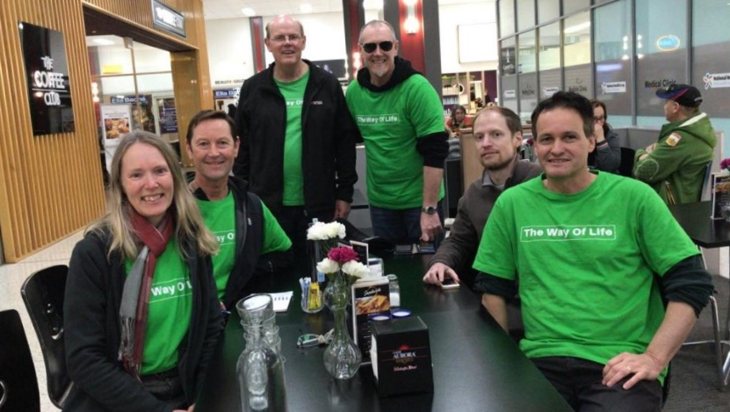
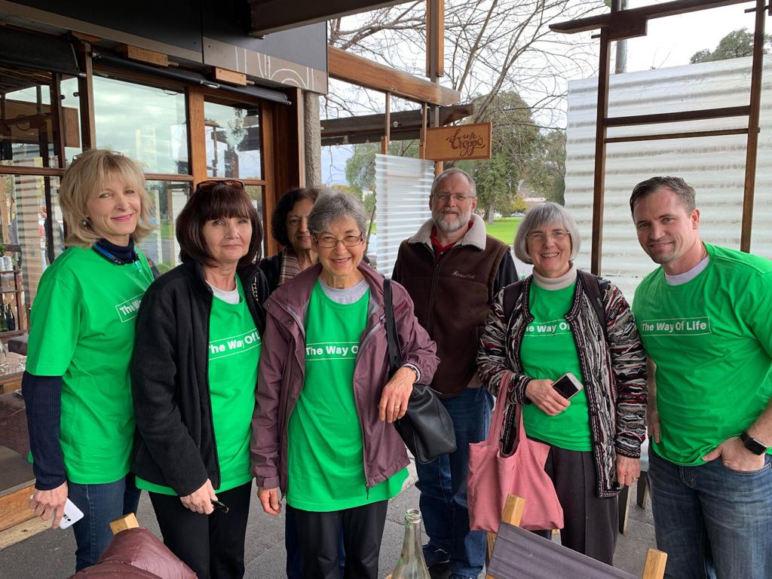
Teams to Reach Souls
BELCONNEN, ACT
WHITMORE SQUARE ADELAIDE

Slide 11
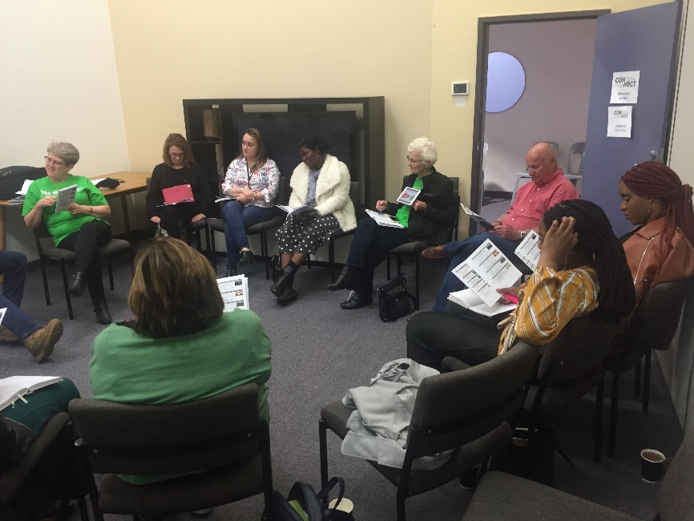
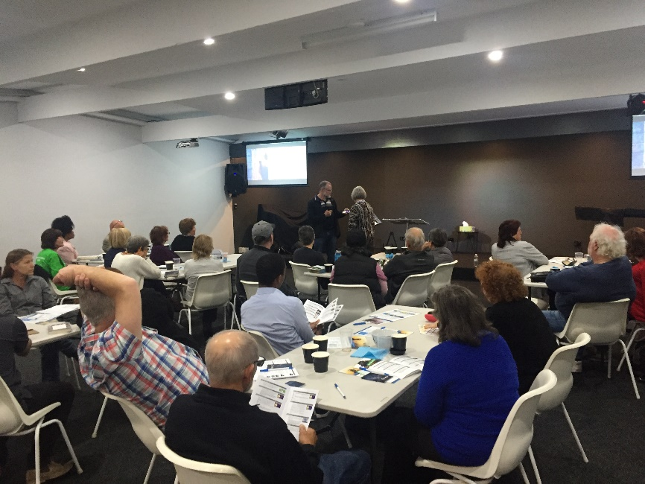
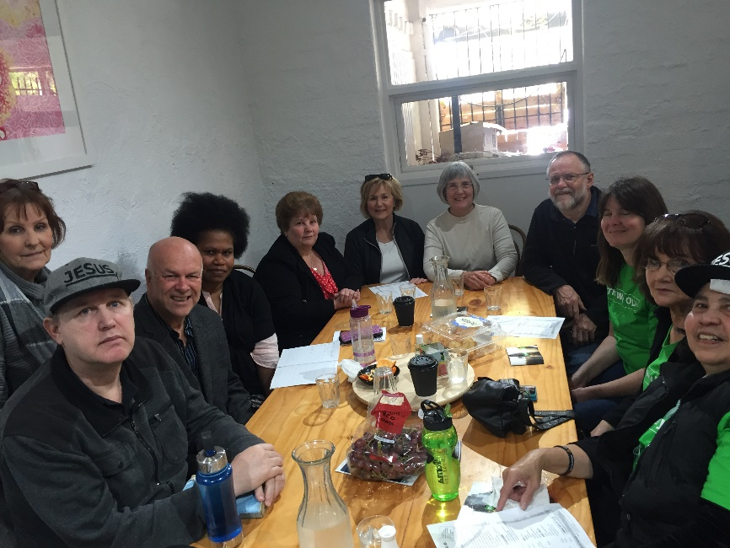
Training to Reach Souls
PERTH
ADELAIDE CBD
ADELAIDE NORTH

Slide 12
Praying For Souls

Slide 13
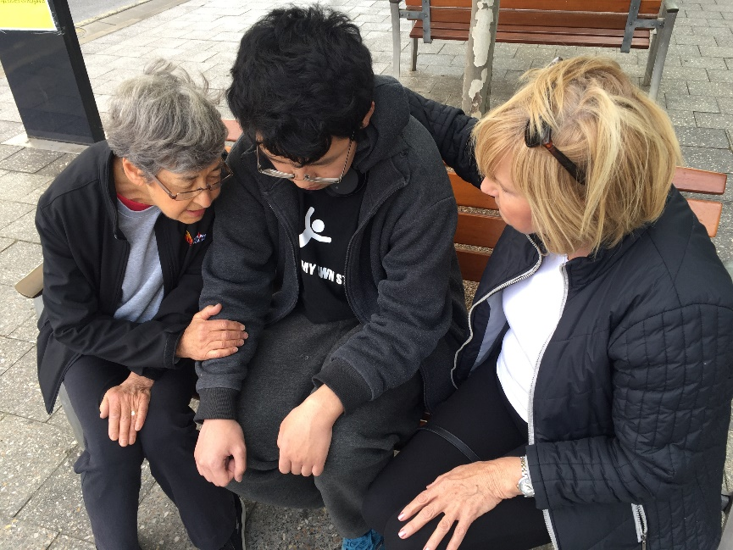
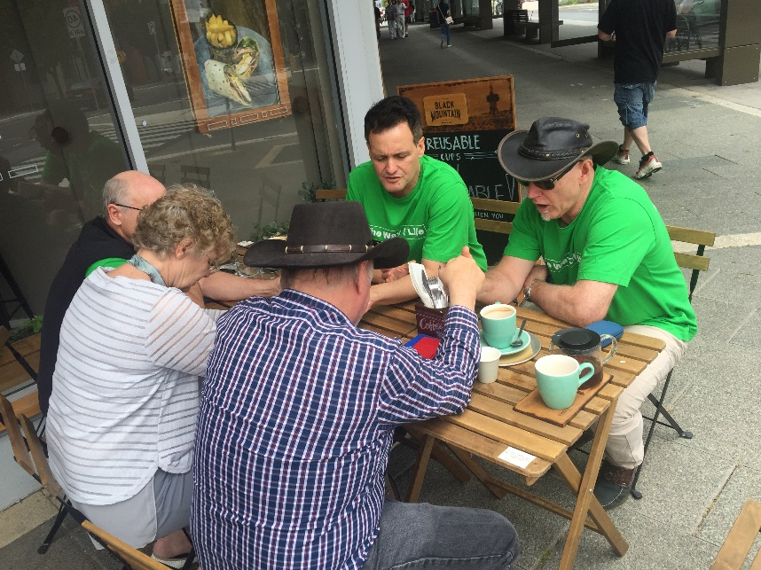
Praying For Souls
ADELAIDE
GUNGHALIN, ACT

Slide 14
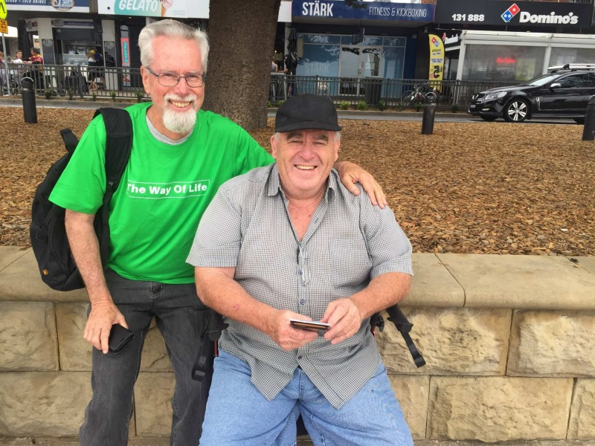
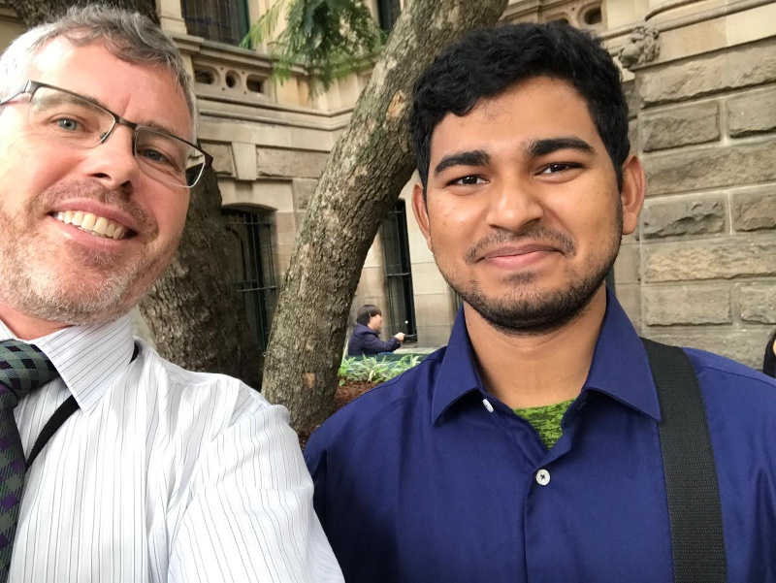
Saving Souls
TERRIGAL, NSW
SYDNEY, CBD

Slide 15
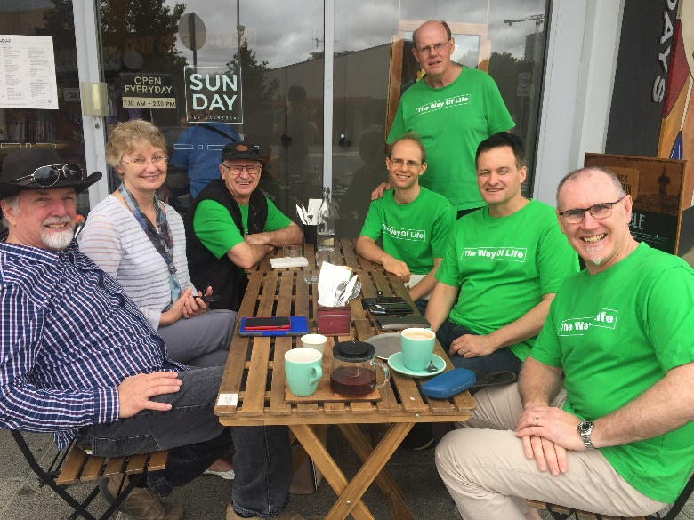
The Next Steps to help win more Souls in …
Melbourne
Tasmania
Northern Territory
Queensland
New Zealand
We need your Prayer support
Your Financial support - www.afj.org.au
Register on www.afj.org.au
Join a Team
Learn how to reach the lost
Take action whilst there is time!

Slide 16
Praying For Souls

