Slide 1
How YOU can Bring Others to JESUS

Slide 2
What does God want You to do?

Slide 3
The FIRST Words of Jesus …
“Now is the time,” He said “the Kingdom of God is near: repent and believe the Good News.”
Mark 1:15

Slide 4
The LAST Words of Jesus …
“GO into all the world and preach the Gospel to every creature. He who believes and is baptised will be saved; but he who does not believe will be condemned.”
Mark 16:15

Slide 5
How can YOU do this …
PRAY …

Slide 6
How can YOU do this …
… for LOST people.

Slide 7
Where are they …?
ALL around You

Slide 8
How do you PRAY…?
Once a week or every day …
with friends …
… for at least an hour.

Slide 9
Where do you PRAY…?
At church or home …
preferably at church with a group

Slide 10
PRAY by Name
Be specific …
Pray for those whom God has laid upon
your
This Photo by Unknown Author is licensed under CC BY-SA

Slide 11
THEN … go and see people
Ask them …?
Pray for them.
Ask them later, “how are things …?”

Slide 12
Offer to show them the GOOD NEWS
Use The Way of Life

Slide 14
Offer to show them the GOOD NEWS
Use The Way of Life
Help them understand
Encourage them to PRAY

Slide 15
Offer to meet again …
Begin with John one …
Explore the scripture
Explain how Jesus saves

Slide 16
If they have prayed to receive Christ
Encourage and bring to church
Help them explore baptism (with your pastor’s help)

Slide 17
If they have NOT prayed to receive Christ
Encourage and bring to church
Help them explore the Gospel further

Slide 18
We summarise these steps as …
PRAY … for the LOST
PRESENT the GOOD NEWS
PARENT spiritually those who come to faith

Slide 19
What are the RESULTS of doing these things?

Slide 20
People are coming to faith and joining churches

Slide 21
People are growing in faith

Slide 22
People are going on in Christ

Slide 23
People are getting involved in sharing the GOOD NEWS

Slide 24
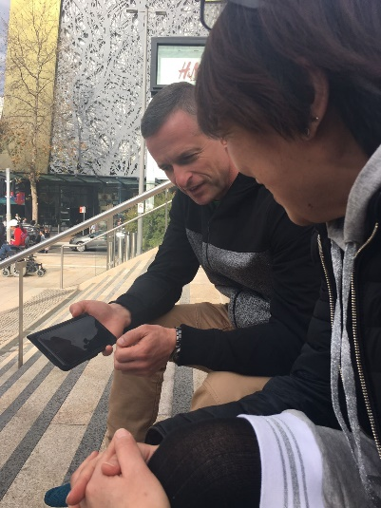
TOOLS

Slide 32
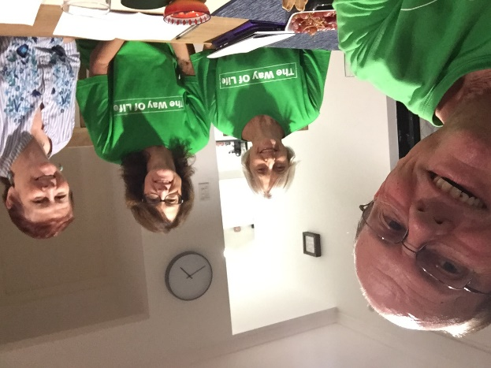
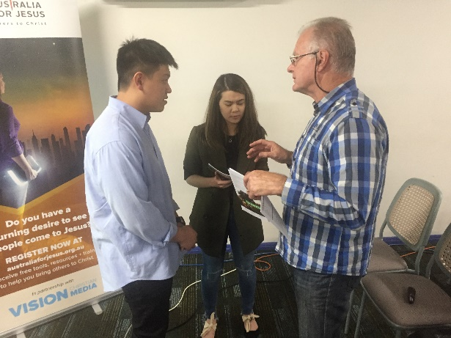
TRAINING

Slide 33
Results as at 20th July 2019
1123 Partial presentations
1382 Full Presentations
263 Campaigns
611 Sinner’s prayers

Slide 34
Set up your own Campaign
www.afj.org.au/twolcampaign/

Slide 35
Use this Personal Link to Develop Your Skill
www.afj.org.au/twolcampaign-personal/

Slide 36
“Light The Fires” Conference Canberra House of Prayer – 16 -18 August 2019
AUSTRALIA FOR JESUS INVITES YOU TO JOIN US FOR THIS NATION CHANGING CONFERENCE at
The Canberra House of Prayer
28 Guilfoyle St, Yarralumla, ACT

Slide 37
“Light The Fires” Conference Canberra House of Prayer – 16 -18 August 2019
Registration:
Registration Form: fill out the form and send to Jenny Lyons at jenlyons0208@gmail.com
Register by 30th June 19: and receive $30 discount off Conference Fee – or free copy
of The Soul Winner by Charles Spurgeon
Registrations to be finalised by: Tuesday 6th August 2019
Call Jenny on 0412 611 184

Slide 38
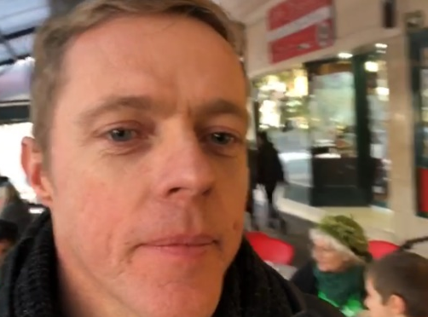
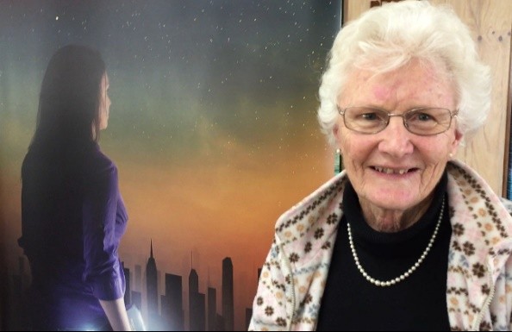
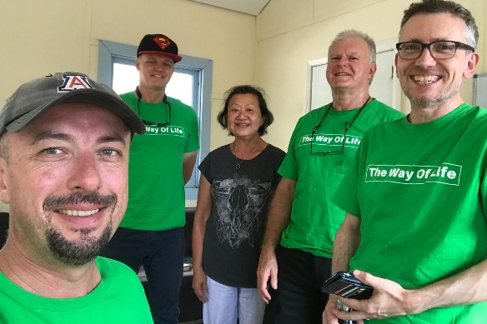
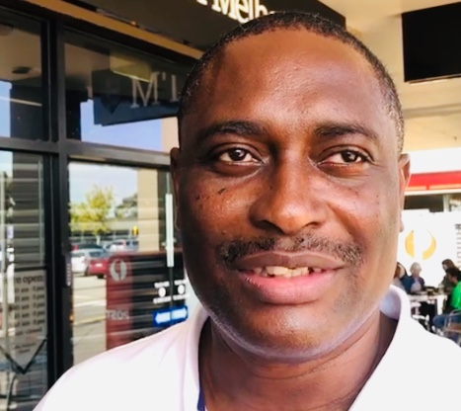
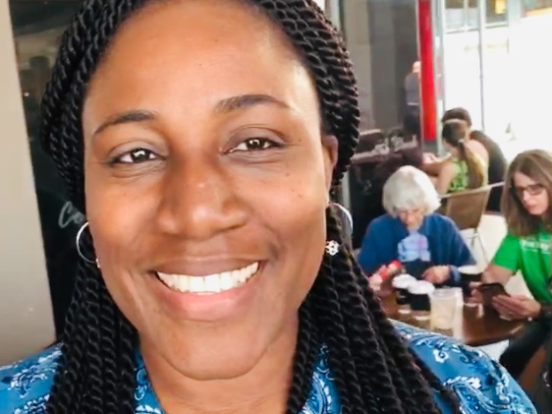
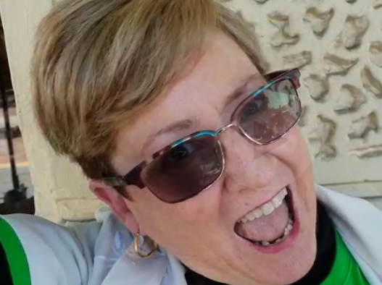
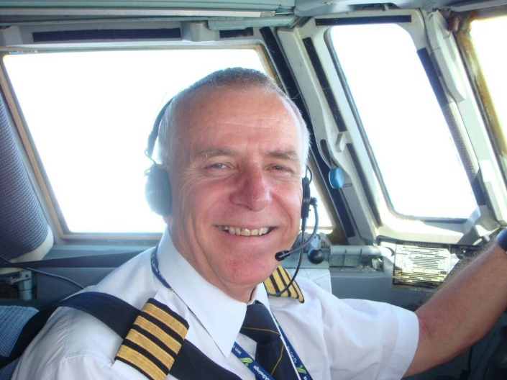
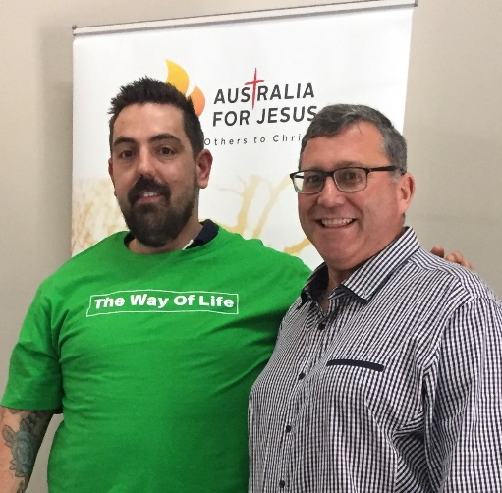
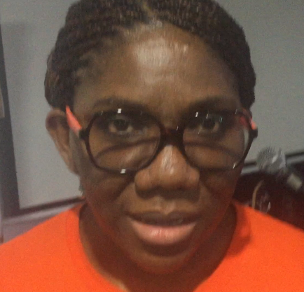
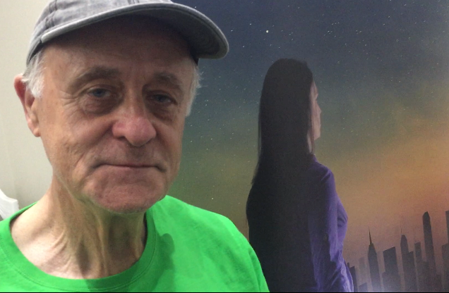
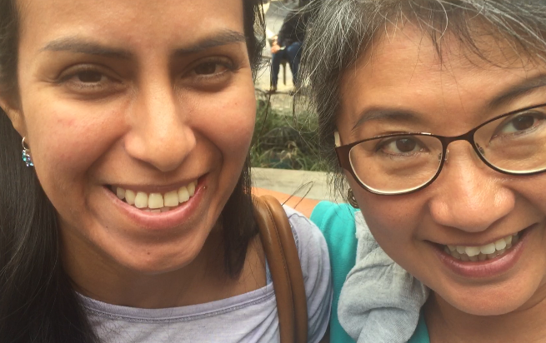
Will YOU join us in the GOD Revolution?

Slide 39
www.afj.org.au

